Slide 1
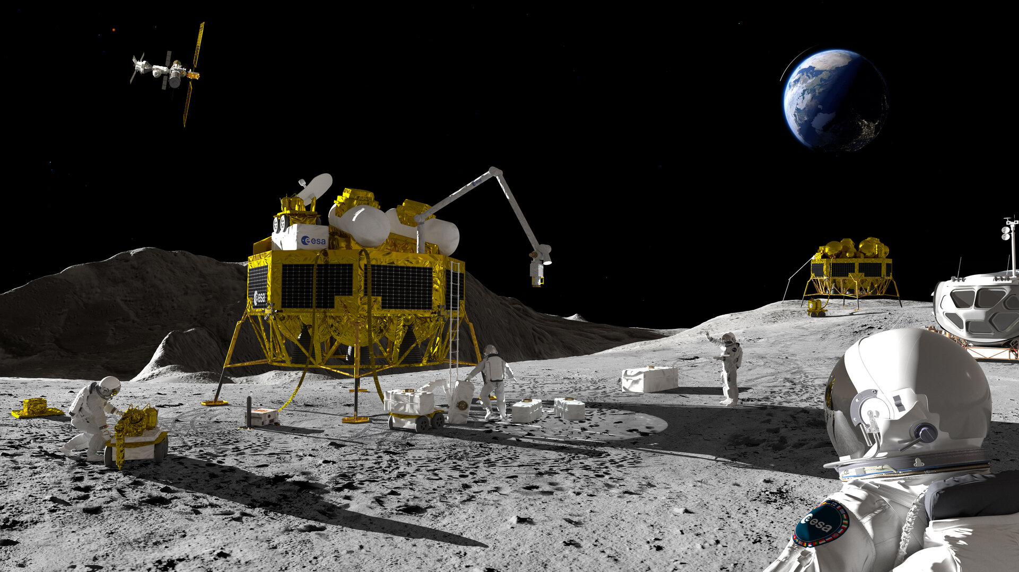
GROUP 10
SPACE robot
01
01

Slide 2

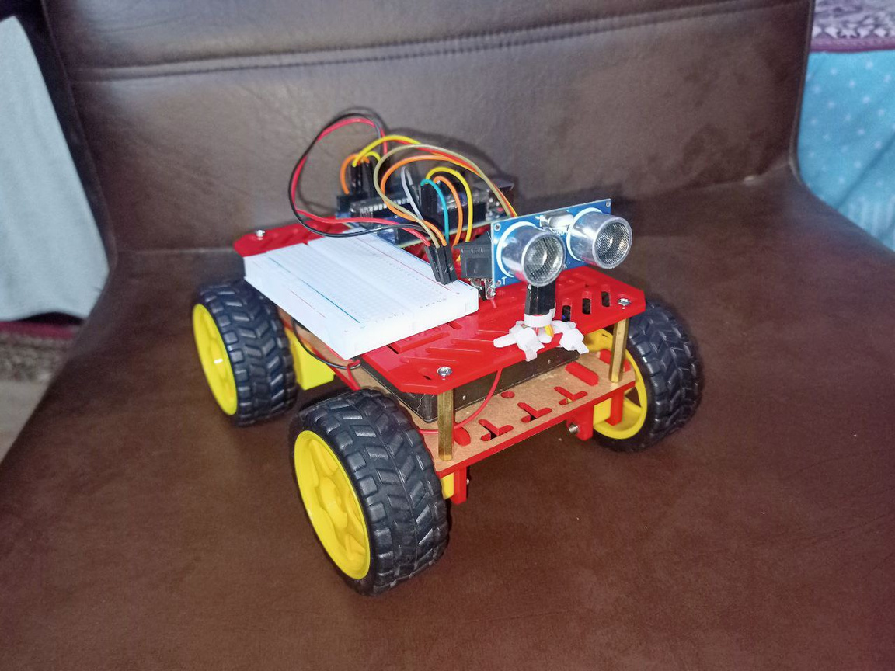
Introduction
Obstacle Avoiding Robot is an intelligent device that can automatically sense the obstacle in front of it and avoid them by turning itself in another direction. This design allows the robot to navigate in an unknown environment by avoiding collisions, which is a primary requirement for any autonomous mobile robot. The application of the Obstacle Avoiding robot is not limited and it is used in most of the military organizations now which helps carry out many risky jobs that cannot be done by any soldiers.
02

Slide 3
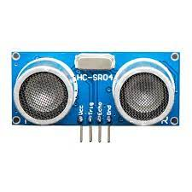
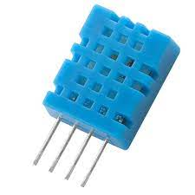

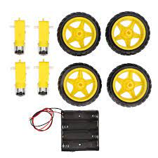
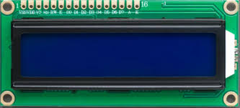
COMPONENTS :
1- ARDUINO UNO (ANY VERSION)
2- HC-SR04 ULTRASONIC SENSOR
3- L298 MOTOR DRIVER MODULE
4- JUMPER WIRES MALE MALE
5- JUMPER WIRES MALE FEMALE
6- BO DC MOTORS
7- BRC 18650 BATTERY
8-LIQUID CRYSTAL DISPLAY
9- WHEELS
10- CHASSIS
11- DHT11 SENSOR
03

Slide 4
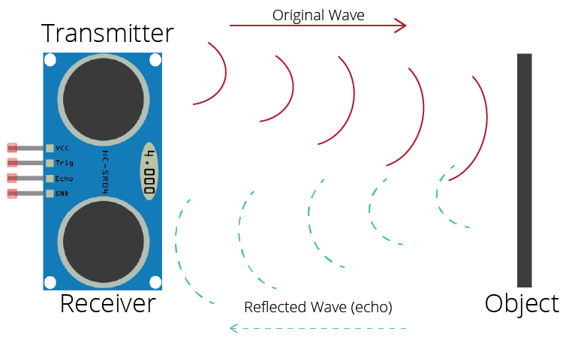
ULTRASONIC SENSOR
WE USED ULTRASONIC SENSORS BECAUSE IT COMMONLY USED IN OBSTACLE AVOIDANCE CARS BECAUSE THEY ARE A RELATIVELY INEXPENSIVE AND EASY-TO-USE WAY TO MEASURE DISTANCE. THE SENSOR WORKS BY EMITTING A HIGH-FREQUENCY SOUND WAVE AND THEN MEASURING THE TIME IT TAKES FOR THE WAVE TO BOUNCE BACK FROM AN OBJECT. THE DISTANCE TO THE OBJECT CAN THEN BE CALCULATED USING THE SPEED OF SOUND.
04

Slide 5
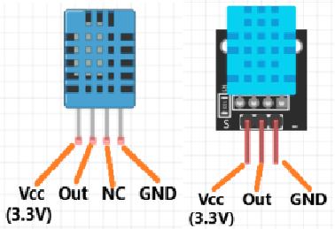
DHT11 SENSOR
DHT11 CAN BE USED IN A VARIETY OF WAYS IN SPACE ROBOTS. FOR EXAMPLE, IT CAN BE USED TO MONITOR THE TEMPERATURE AND HUMIDITY INSIDE THE ROBOT, WHICH CAN HELP TO ENSURE THAT THE ROBOT IS OPERATING WITHIN ITS SAFE OPERATING LIMITS. THE DHT11 CAN ALSO BE USED TO MEASURE THE TEMPERATURE AND HUMIDITY OUTSIDE THE ROBOT, WHICH CAN BE USED TO GATHER DATA ABOUT THE ENVIRONMENT IN WHICH THE ROBOT IS OPERATING.
05

Slide 6
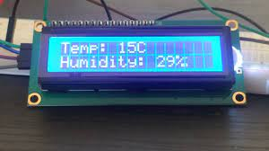
LCD
LCD CAN BE USED TO DISPLAY THE TEMPERATURE AND HUMIDITY DATA THAT IS COLLECTED BY THE DHT11. THIS DATA CAN BE USED BY THE ROBOT'S OPERATOR TO MONITOR THE HEALTH OF THE ROBOT AND THE ENVIRONMENT IN WHICH IT IS OPERATING.
06

Slide 7

Arduino Uno
THE ARDUINO UNO IS A POPULAR MICROCONTROLLER BOARD
1- IT IS RELATIVELY INEXPENSIVE:
2- IS EASY TO USE
3- IT IS COMPATIBLE WITH A WIDE RANGE OF SENSORS AND ACTUATORS
07

Slide 8
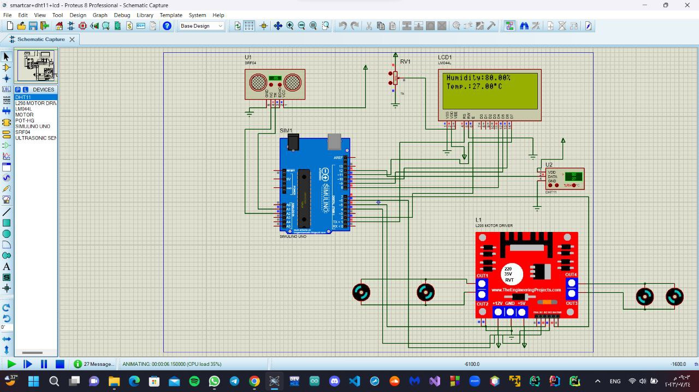
Circuit Of Project:
08

Slide 9
09

Slide 10
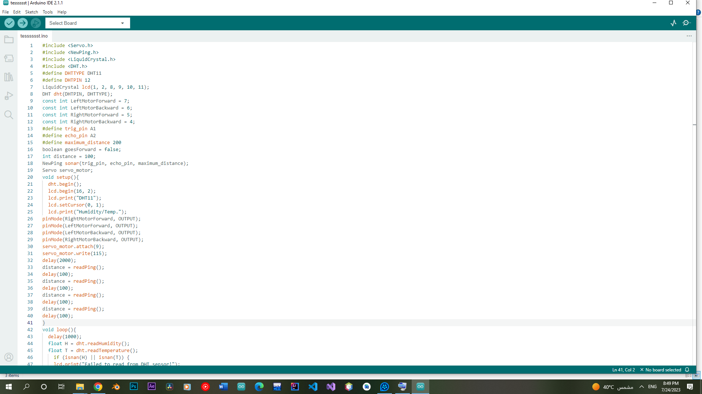
CODE OF ROBOT
10

Slide 11
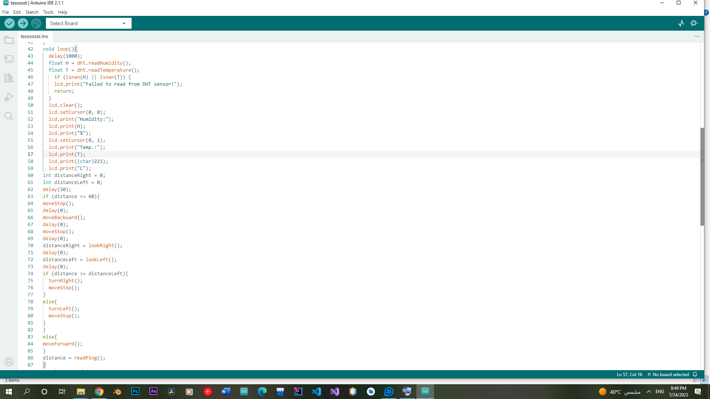
11

Slide 12
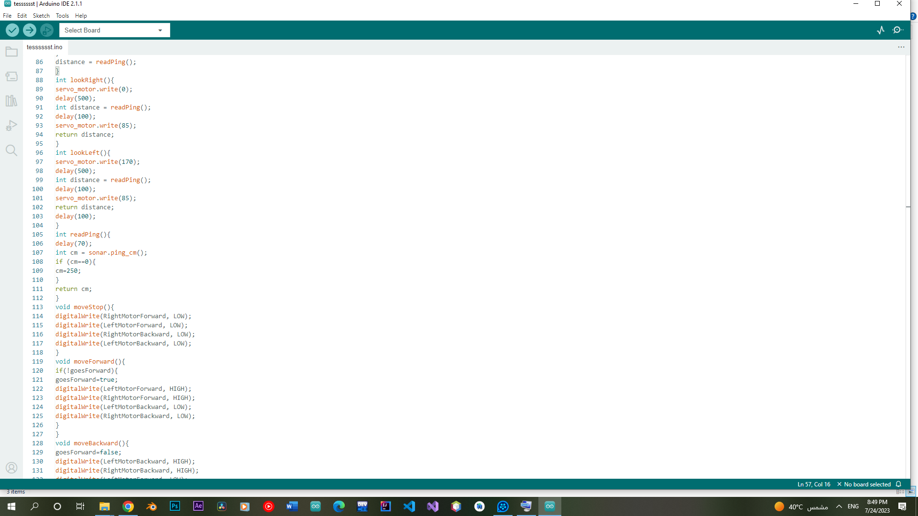
12

Slide 13
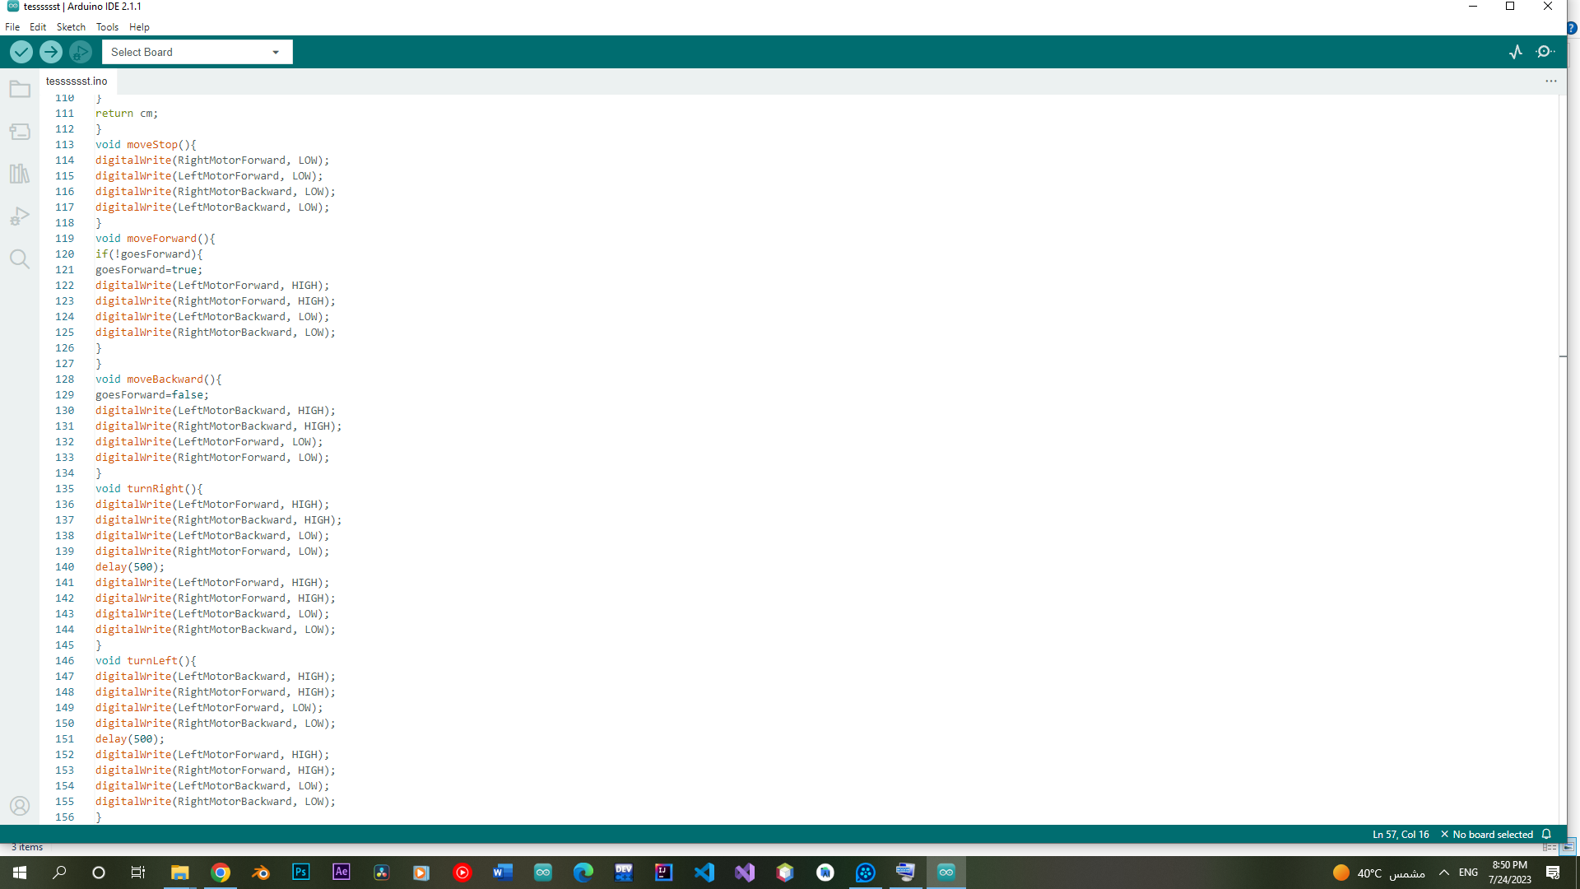
13

Slide 14

عمل الطلاب:
على عبدالمنعم على ابراهيم
احمد زكريا عبدالعال يوسف
رحمه احمد يوسف امين
ايثار عدنان ابراهيم البليدي
اسراء مجدي محمد نجيب
احمد محمد محمود
اشرف محمد ابراهيم ابوزيد
احمد فتحى عواد عامر
احمد محمد عاطف
14

